Slide 1
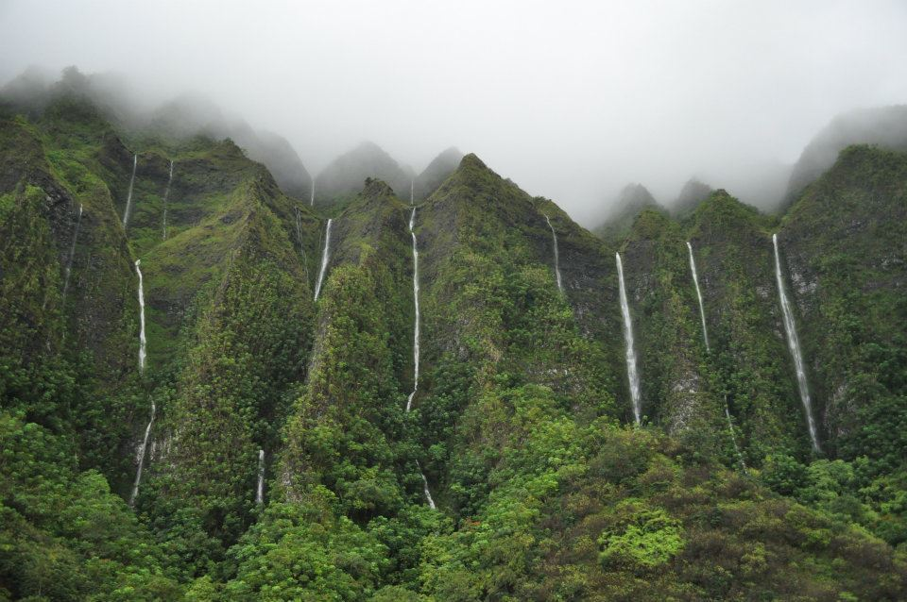
Lesson 2: Watersheds
Notes:
Ask your students what they think a watershed is?

Slide 2
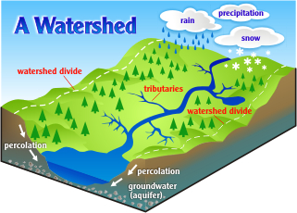
Notes:
A watershed is an area of land, such as a mountain or valley, which collects rainwater into a common outlet. In Hawai‘i, the common outlet is ultimately the ocean. An easy definition is watershed is land that captures and stores water.

Slide 3
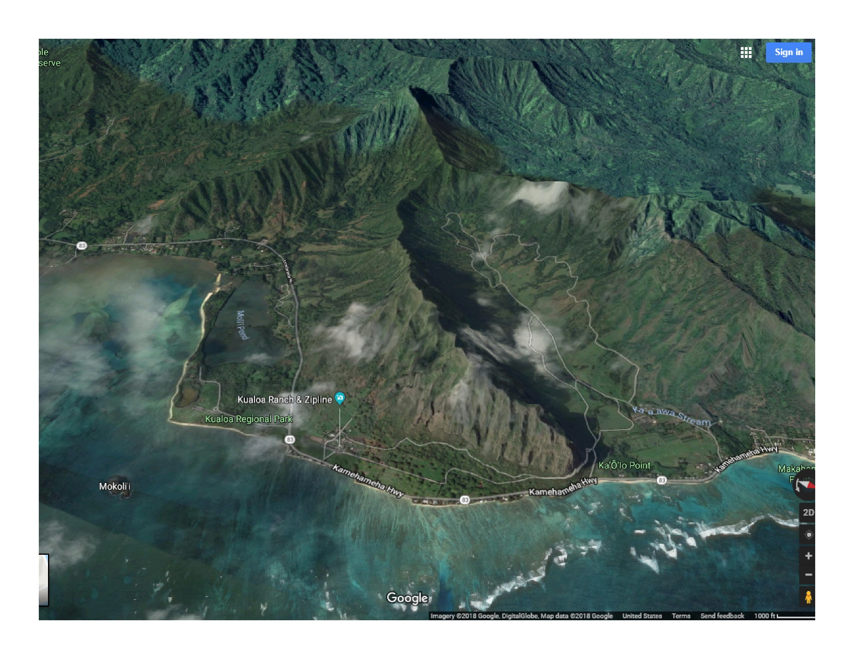
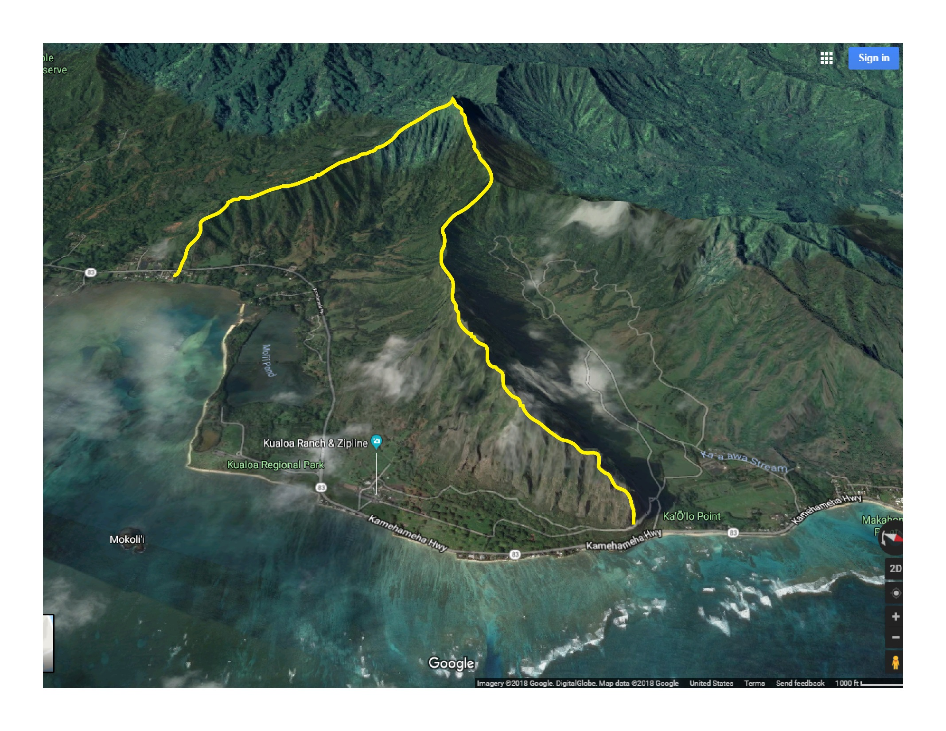
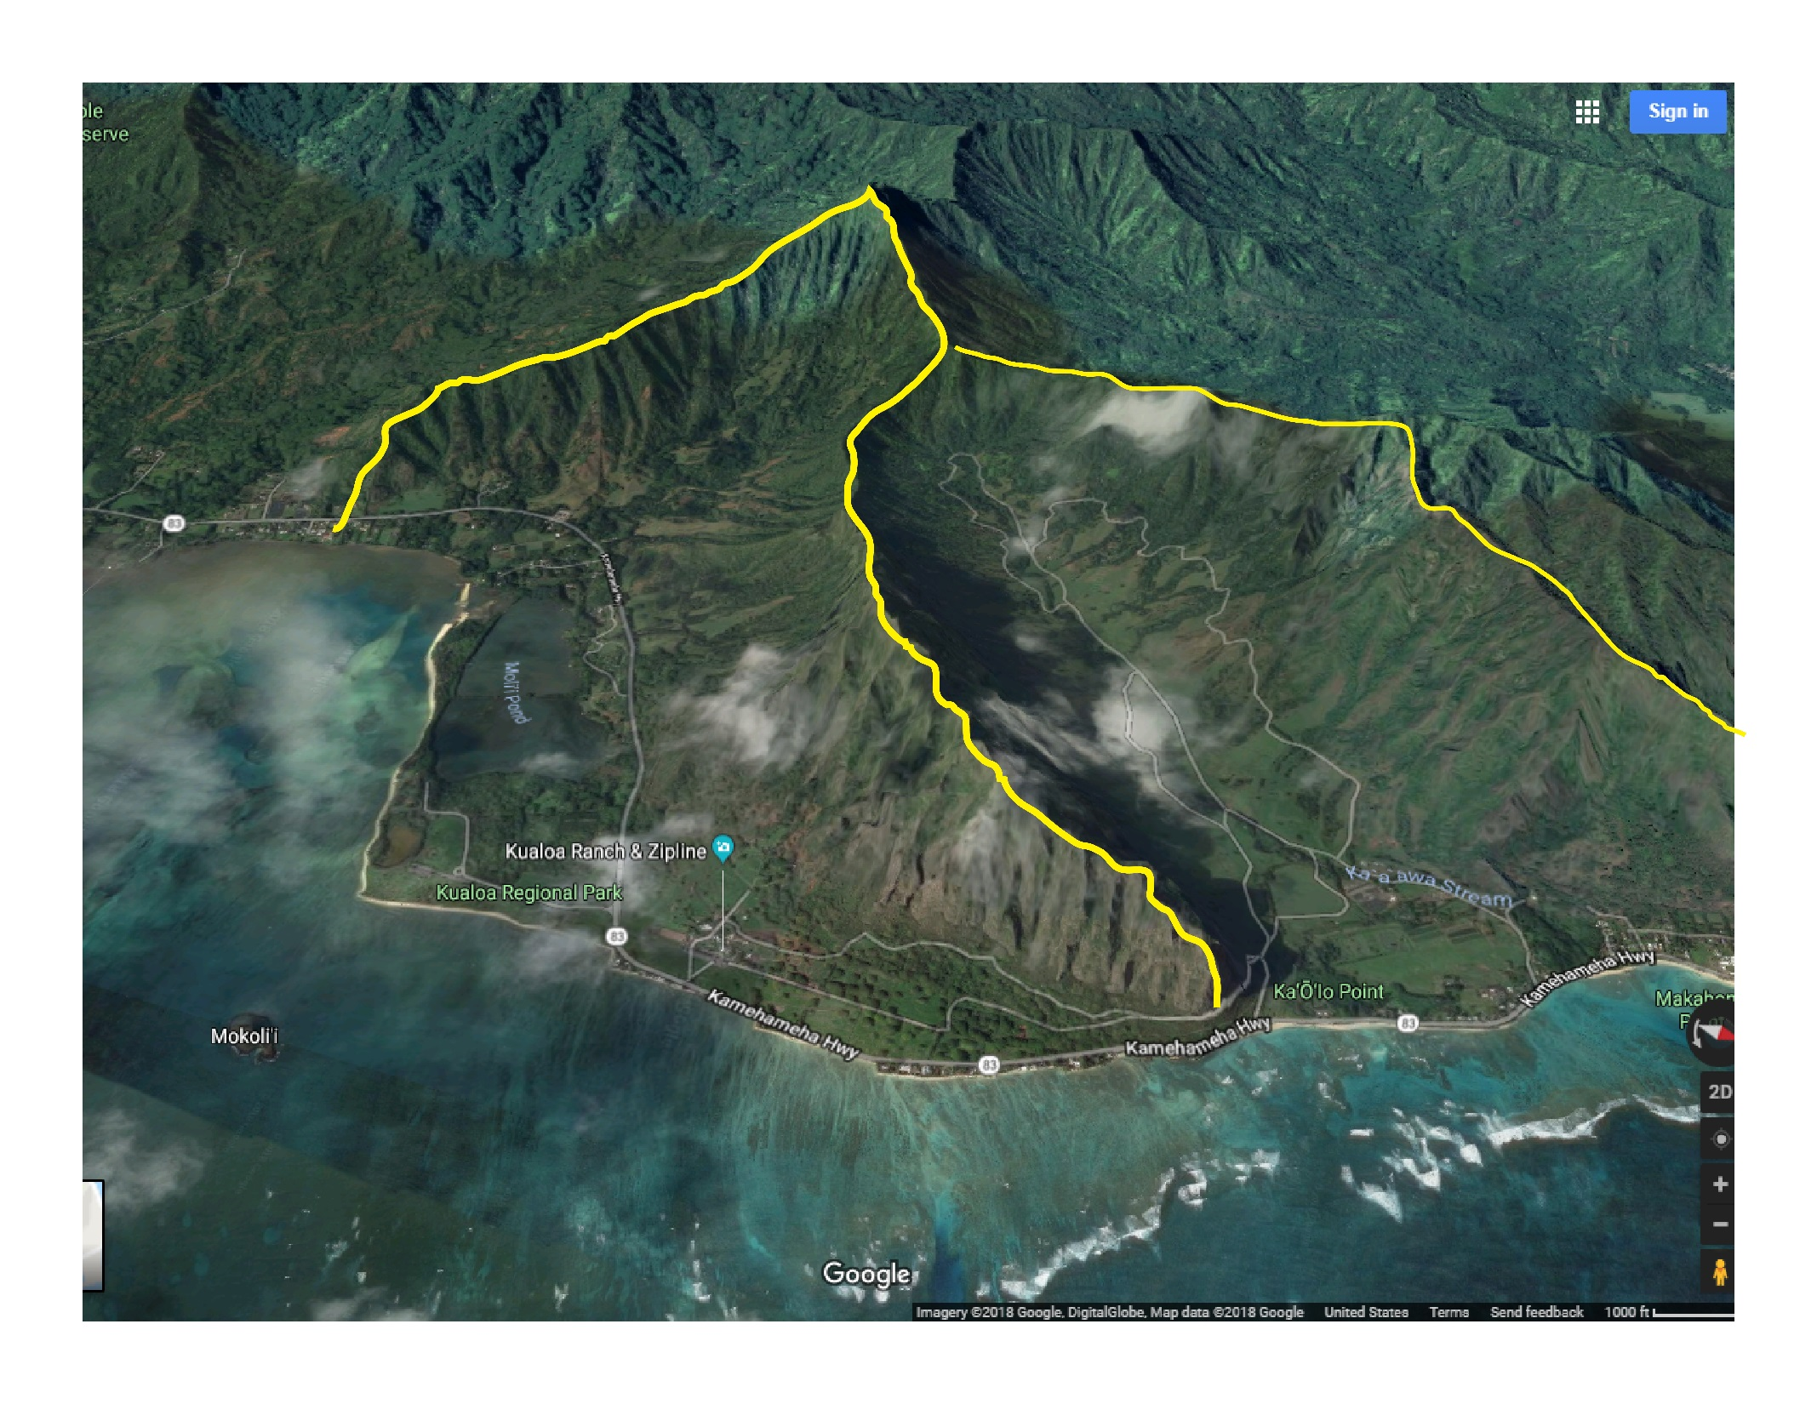
Notes:
Watersheds come in all different shapes and sizes. Their boundaries are determined by the shape of the land (topography). Here, you can see these two watersheds are divided by the mountain ridges.
*This slide has 2 animations with mouse click to reveal the watershed boundaries.

Slide 4
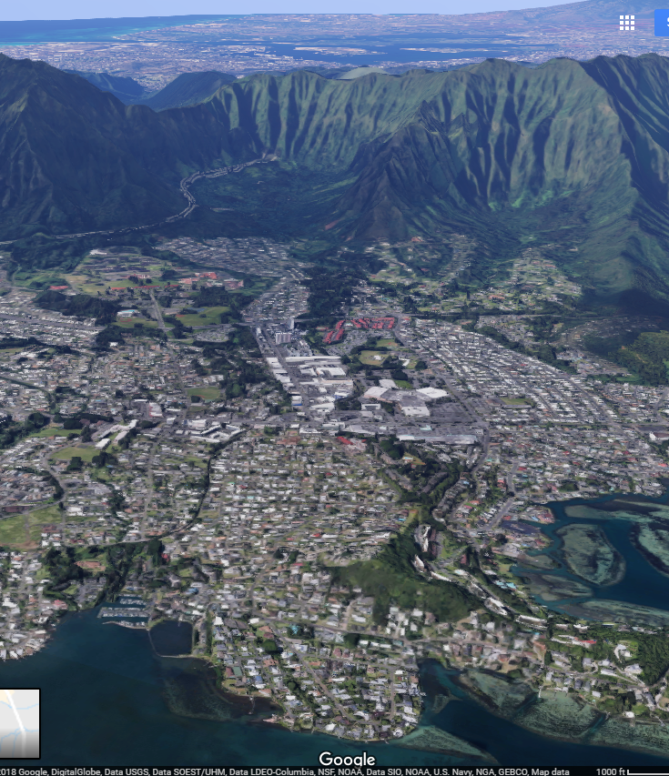
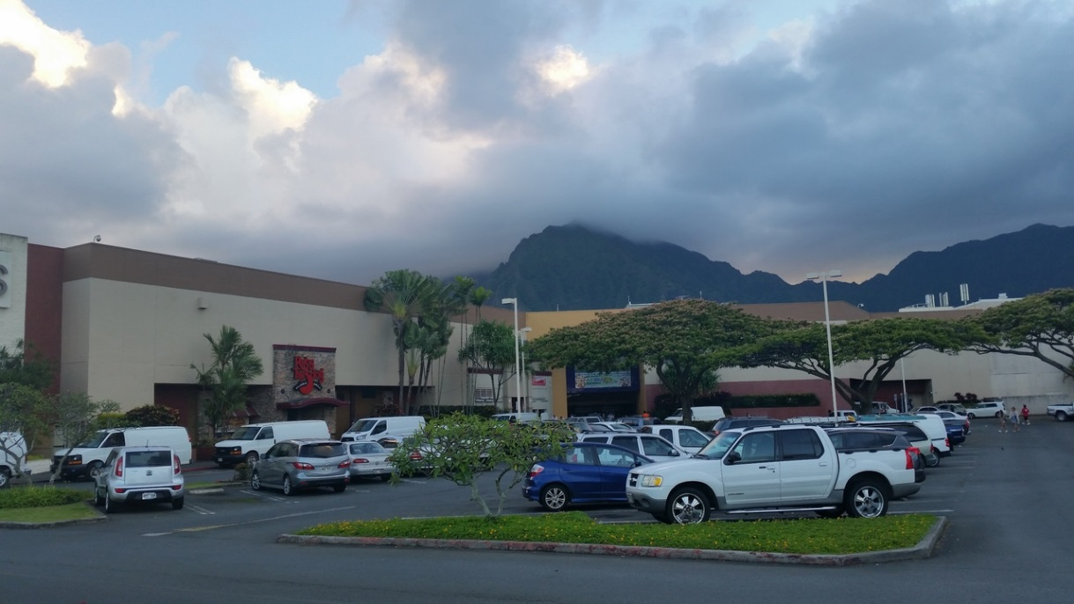
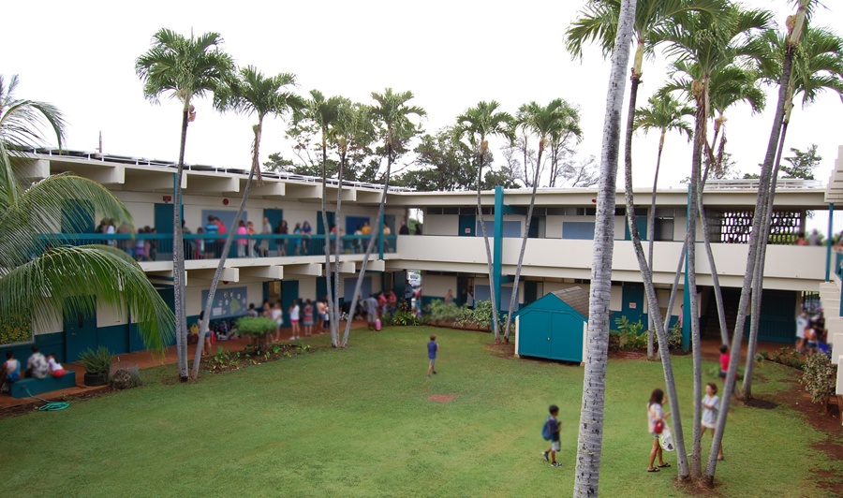
What’s in a watershed?
Notes:
Everyone on the planet lives in a watershed! Your school and home are in a watershed. Forests, farms, stores, parks, and roads are all in a watershed.

Slide 5
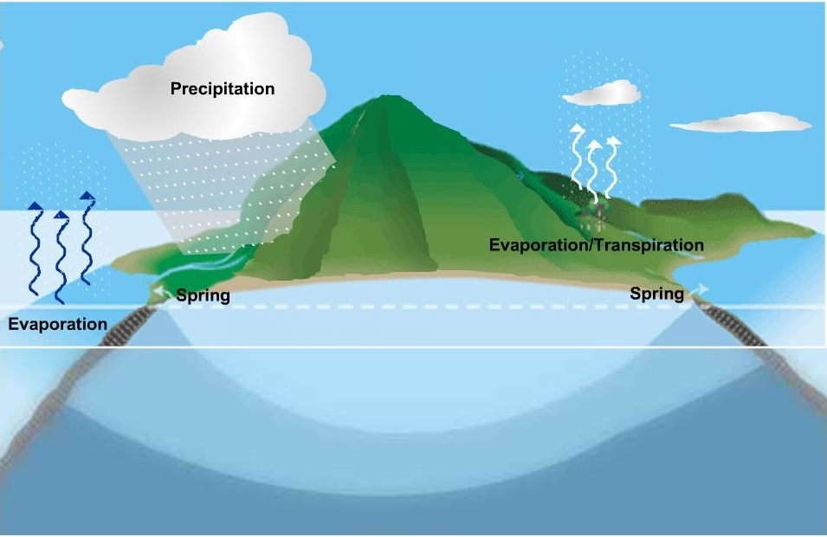
The Water Cycle
Notes:
Review the water cycle:
The sun’s heat cause water to change to vapor…this is called evaporation, which then come together and form clouds (condensation).
Precipitation: clouds then drop moisture as rain.
*For further discussion: Plants also use the water in the soil, which is released from their leaves (transpiration) back into the atmosphere through evaporation. This is called, evapotranspiration. Evapotranspiration is increased by heat and sun, releasing more water into the atmosphere. Cooler days suppress this process, generating fog and condensation keeping water in plants and in the ground…essentially increasing water retention.

Slide 6
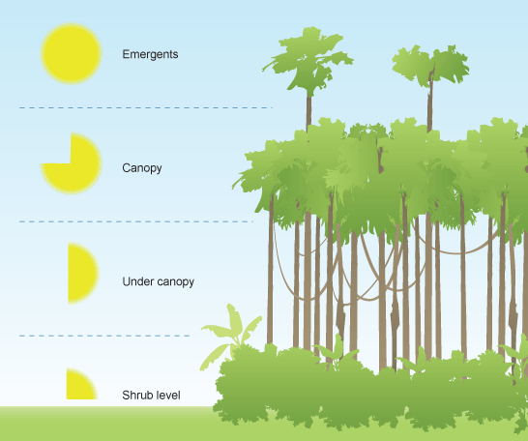
Forest Layers help collect water.
Subcanopy
Ground Cover
Notes:
Forests are made up of many different kinds of trees, shrubs, ferns, and mosses. They are all different sizes and shapes and depending on how tall the plant gets, it will live in a different layer of the forest.
Hawai‘i’s forests have 4 basic layers:
Emergent: These are the tallest trees in the forest slow down heavy raindrops and pull moistures from passing clouds.
Canopy: This layer catches most of the raindrops and water flows down the branches, to its trunk and to the ground.
Subcanopy: This layer absorbs tree drips from the layers above. It also covers the layer below to slow evapotranspiration.
Ground Cover: Mosses and ferns form a spongy layer that holds water and covers the soil so it doesn’t wash away into streams an oceans. This is the darkest part of the forest. The less sun’s energy means less evaporation and evapotranspiration.
Source: http://www.boardofwatersupply.com/water-resources/the-water-cycle

Slide 7
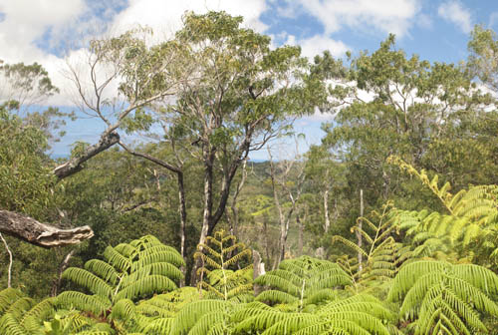
Koa Trees - Emergent Layer
Notes:
Koa trees are some of the tallest in the forest. These are the first tree to slow down the rain, protecting the layer below. They also catch water droplets from clouds that pass by them.

Slide 8
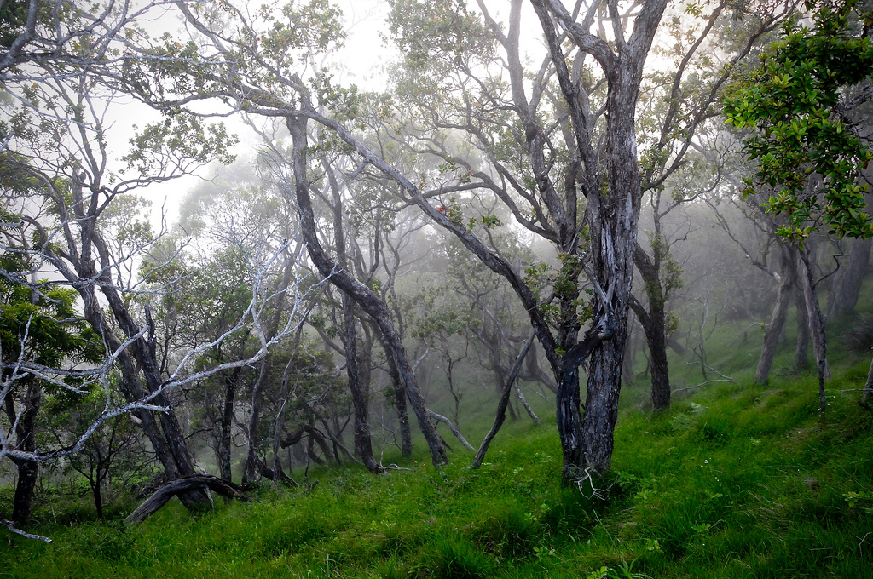
‘Ōhi‘a Trees – Canopy Layer
Notes:
‘Ōhi‘a trees catch most of the raindrops and water flows down the branches, to its rough bark slows the water that flows down the trunk and to the ground. They also help filter sunlight,** protecting the plants below from drying out.

Slide 9
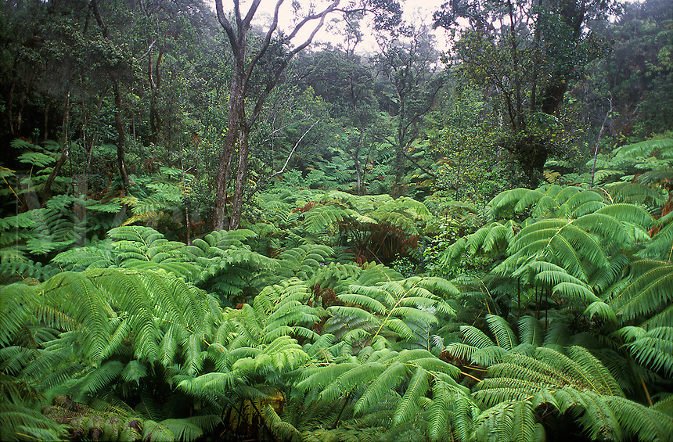
Hapu‘u (tree fern) – Subcanopy Layer
Notes:
These plants catch and absorb tree drips from the layers above. They also cover the ground below to slow evapotranspiration.

Slide 10
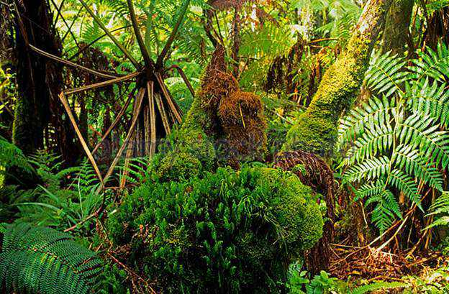
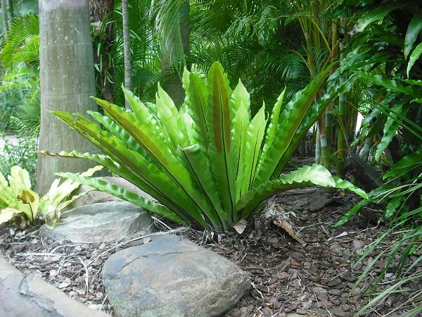
Ferns and moss – ground cover
Ekaha Fern
Notes:
An easy to recognize, native fern is the ekaha fern…or bird’s nest fern.
Mosses and ferns form a spongy layer that holds water and covers the soil so it doesn’t wash away into streams an oceans. This is the darkest part of the forest. A decrease in the sun’s energy means less evaporation and evapotranspiration.

Slide 11
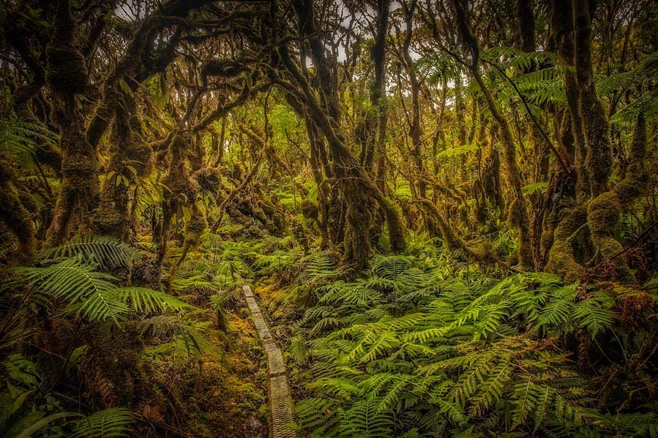
Hawai‘i’s Forests – our water collectors
Photo: Rikki Cooke/THE NATURE CONSERVANCY
Notes:
When it rains, water is capture by plants and soil like a sponge. When they are completely saturated, they release the water slowly into the ground. There it is stored in aquifers. As the water seeps through rock and soil, the water is also filtered so they provide constant, clean water even after the rain stops. Some of this water that runs off is captured and stored on the surface in large ponds called reservoirs. The rest of the water that seeps into the ground is filtered by soils and rock and then captured and stored in open spaces*** called aquifers.

Slide 12
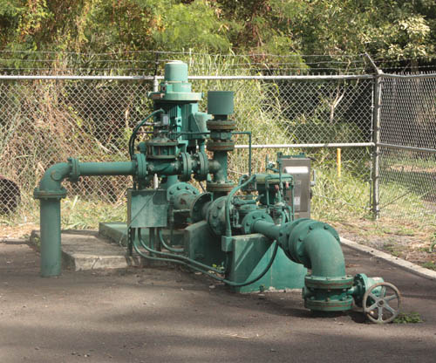
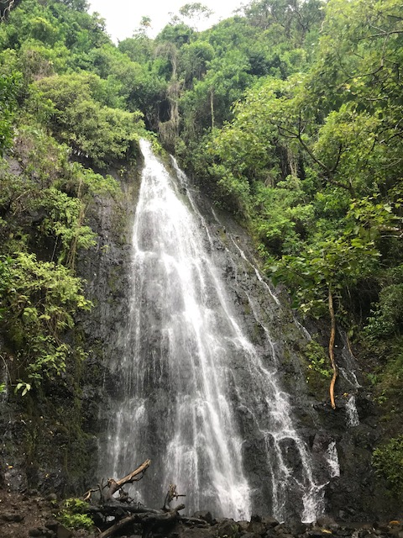
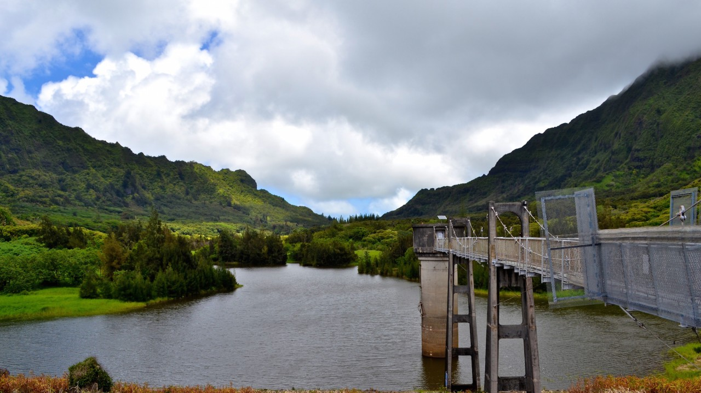
Where does your water come from? WATERSHEDS!
Photo: nearsay.com
Photo: Honolulu BWS
Notes:
Our watershed provide us with the water we use everyday. On O‘ahu, the Board of Water Supply pumps water from reservoirs and aquifers, cleans it, and then sends it to your faucet.
Photos: (top)Nu‘uanu Reservoir, (bottom) pump from aquifer, (right) Hamama Falls, O‘ahu.

Slide 13
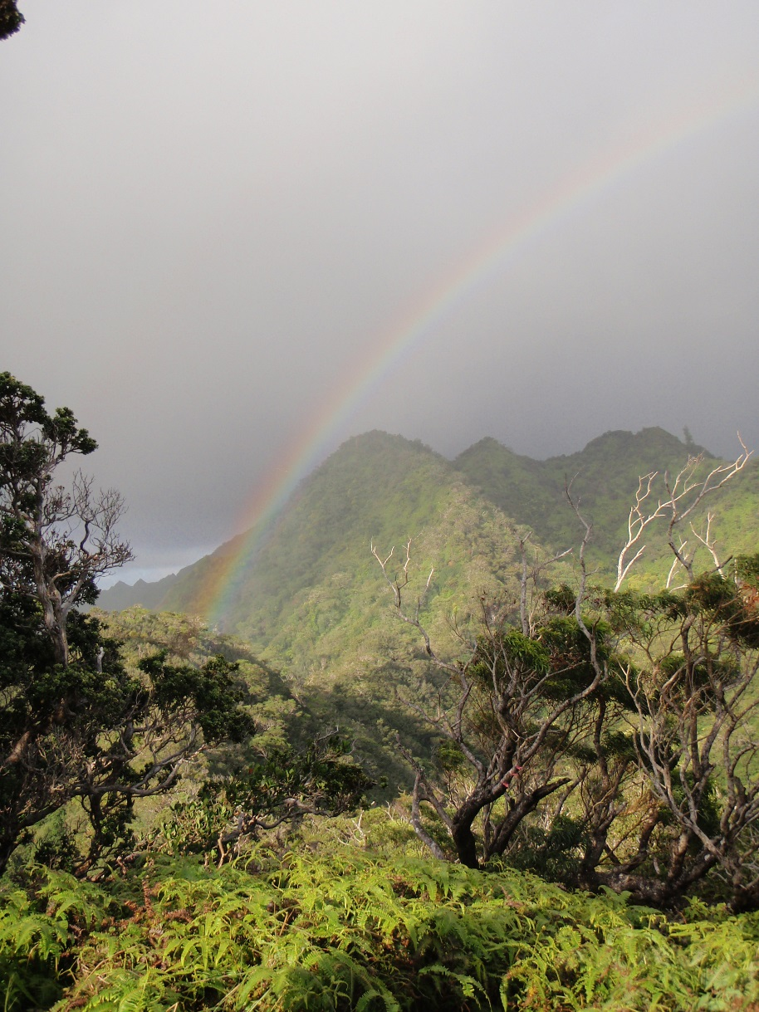
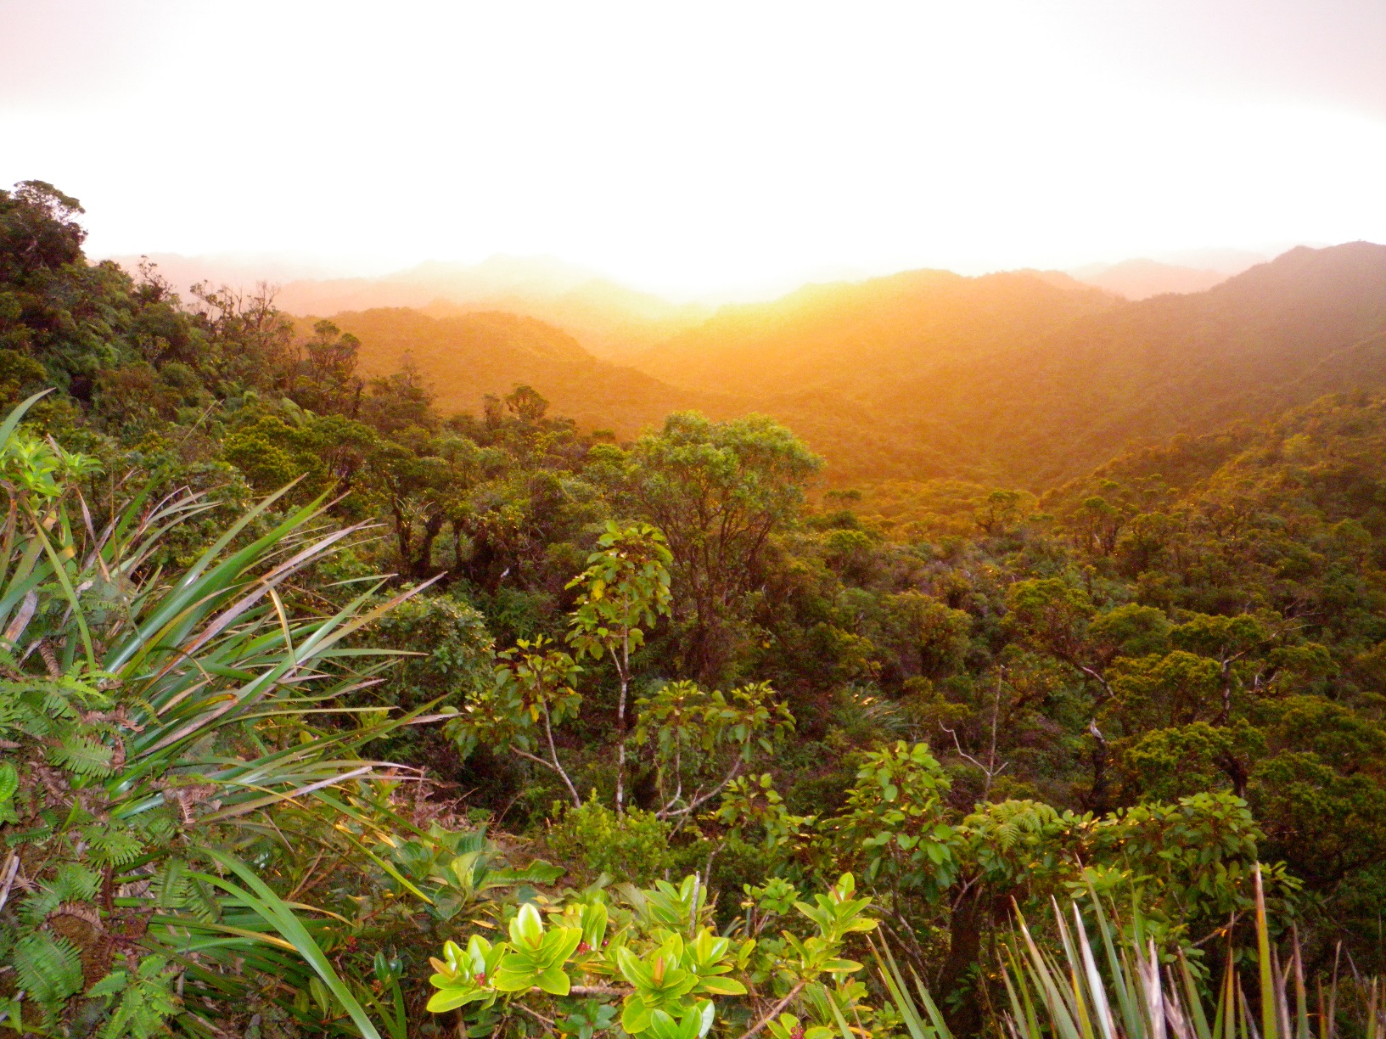
Healthy Forests = Clean Water!

